Slide 1
HTML
Hyper Text Markup Language

Slide 2

Topics
Introduction
HTML Element
Web Browsers
HTML Page Structure
HTML History
Editors

Slide 3
HTML Introduction
HTML is the standard markup language for creating Web pages.
What is HTML?
HTML stands for Hyper Text Markup Language
HTML is the standard markup language for creating Web pages
HTML describes the structure of a Web page
HTML consists of a series of elements
HTML elements tell the browser how to display the content

Slide 4
What is markup language?
A markup language is a type of language used to structure and format text or content on a webpage or document.
It uses tags or symbols to define elements like headings, paragraphs, images, links, and more.
HTML (HyperText Markup Language) is the most common example.
Some examples of markup languages include XML, JSON, RSS, Markdown, and LaTeX.

Slide 5
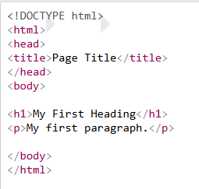
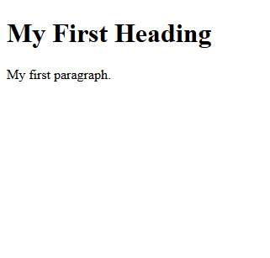
A Simple HTML Document
Code:
Output:

Slide 6
Example Explained
The <!DOCTYPE html> declaration defines that this document is an HTML5 document
The <html> element is the root element of an HTML page
The <head> element contains meta information about the HTML page
The <title> element sets the name that appears in the browser tab.
The <body> element holds all the content you see on a webpage, like text, images, links, and tables.
The <h1> element defines a large heading
The <p> element defines a paragraph

Slide 7
HTML Element
An HTML element is defined by a start tag, some content, and an end tag:
<tagname> Content goes here... </tagname>
The HTML element is everything from the start to the end.

Slide 8
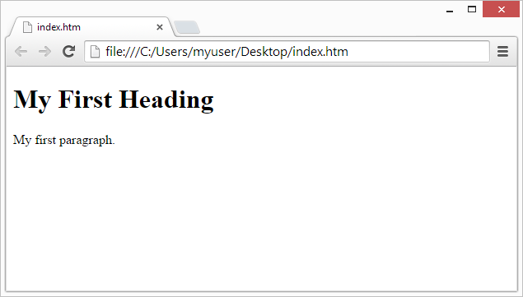
Web Browsers
The purpose of a web browser (Chrome, Edge, Firefox, Safari) is to read HTML documents and display them correctly.
A browser does not display the HTML tags, but uses them to determine how to display the document:

Slide 9
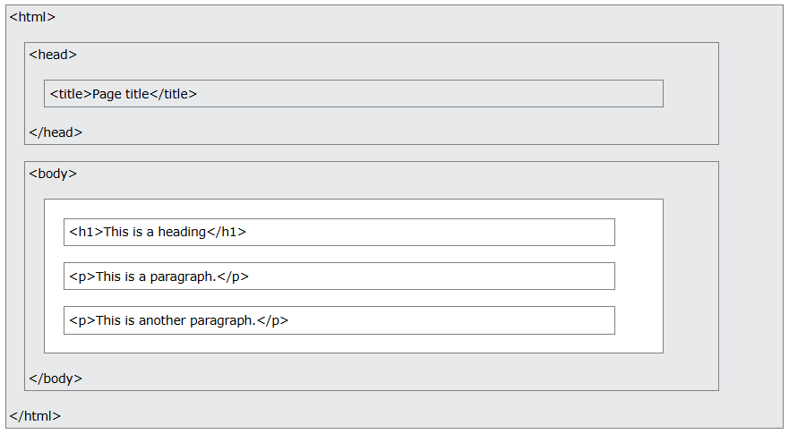
HTML Page Structure

Slide 10
HTML History
1989 Tim Berners-Lee invented www
1991 Tim Berners-Lee invented HTML
1993 Dave Raggett drafted HTML+
1995 HTML Working Group defined HTML 2.0
1997 W3C Recommendation: HTML 3.2
1999 W3C Recommendation: HTML 4.01
2000 W3C Recommendation: XHTML 1.0
2008 WHATWG HTML5 First Public Draft

Slide 11
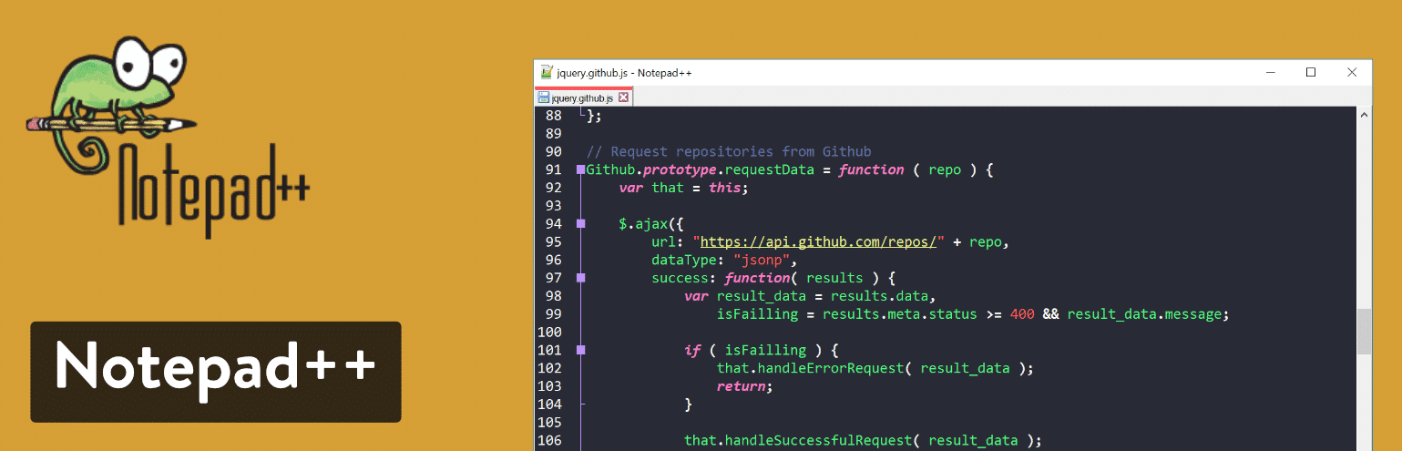
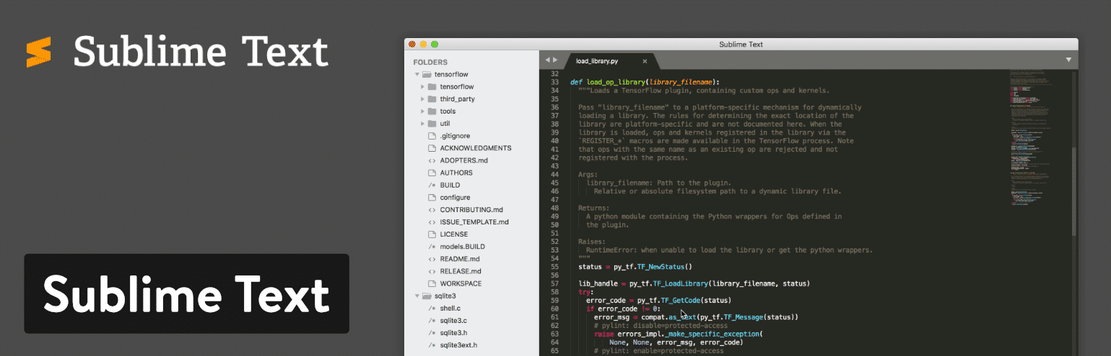
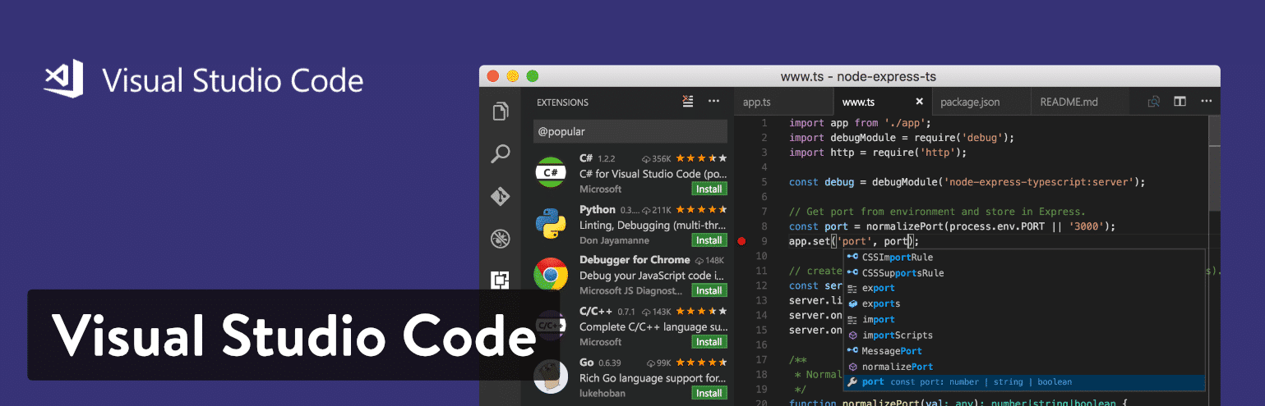
Editors
A simple text editor is all you need to learn HTML.

Slide 12

Thank You
“ HTML is the skeleton of the web. Without it, there is no structure, no meaning, and no way to display content. ”
– Unknown

